Slide 1

PhD Supervisors Meeting
xx/xx/24

Slide 2

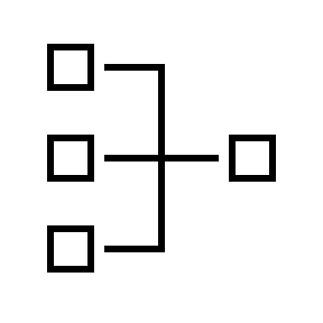

Agenda
REFINED RESEARCH
QUESTIONS
SYSTEM GRAPHIC
ARTICLE SEARCHES

Slide 3
Research Question
Number | Research Question
1 | With the ever-increasing use of IoT devices, can FL algorithms or tools be designed to operate specifically on resources Edge devices to minimize computational and communications costs. The models will have to be adaptable to non independently and identically distributed data (IID)
2 | In any large distributed network, there is a chance that some nodes can be lost, due to a range of issues, such as loss of power, lost of connection and so on. Can a FL architecture be designed that can identify the missing nodes, and adapt so that

